Slide 1
CNN oriented fast HEVC intra-mode Coding Unit depth prediction
Zekuan Zhang

Slide 2
HEVC and CTU/CU/TU…
Intra-prediction, BD-Rate
CNN foundamentals
Other’s network structure and ours
Deep learning in practice…(dataset build/divide, data processing)

Slide 3
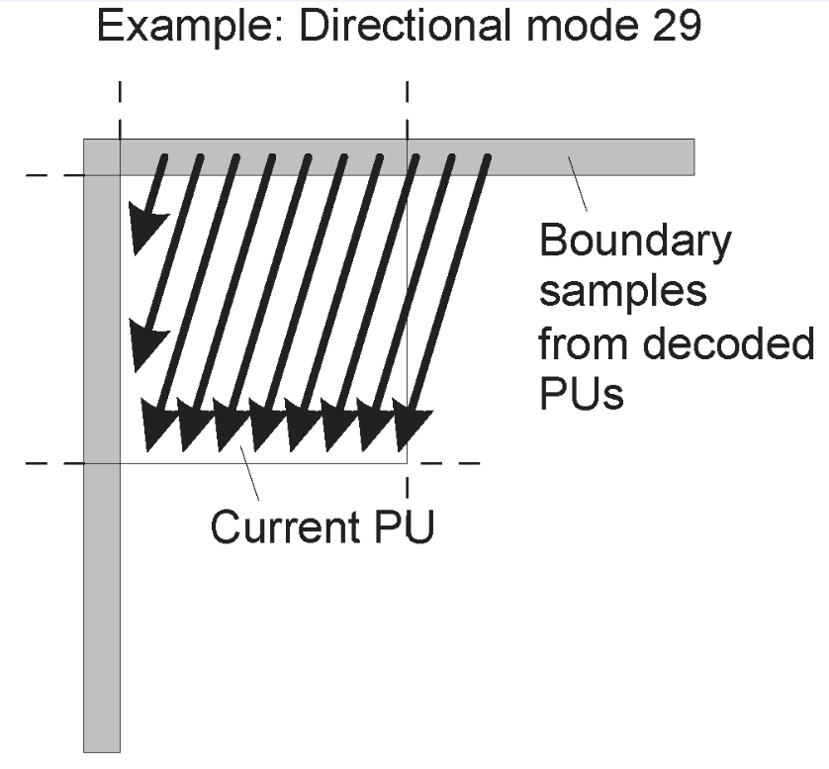
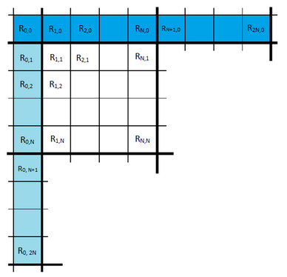
HEVC encoder: intra-prediction
Reference samples
Prediction Unit (PU)
Notes:
若所有参考像素都不可用，则参考像素都用固定值填充

Slide 4
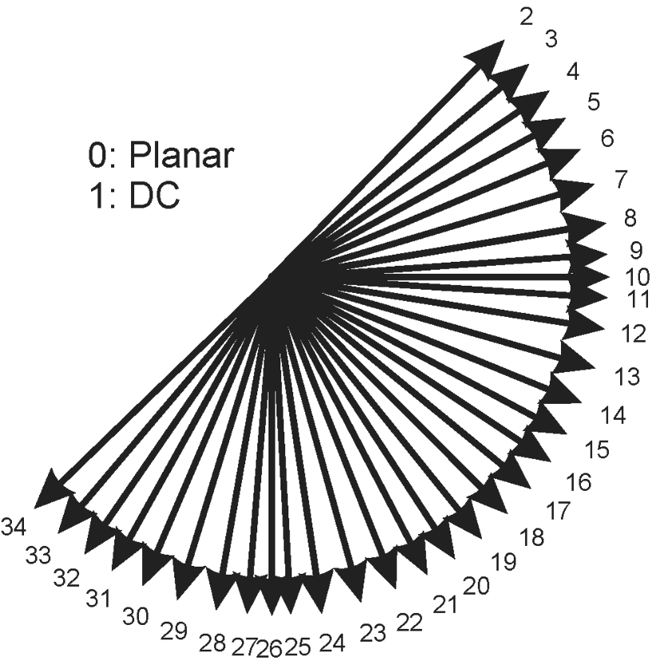
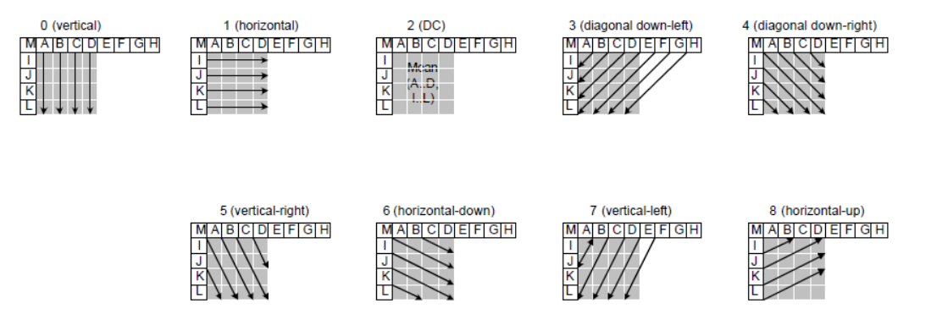
HEVC encoder: intra-prediction
Notes:
Reference:
Intra Coding of the HEVC Standard
Overview of the High Efficiency Video Coding (HEVC) standard
Review on Intra-prediction in High Efficiency Video Coding (HEVC) Standard

Slide 5
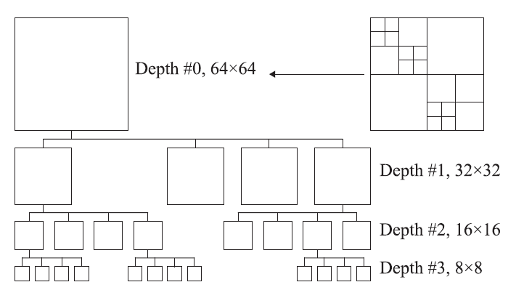
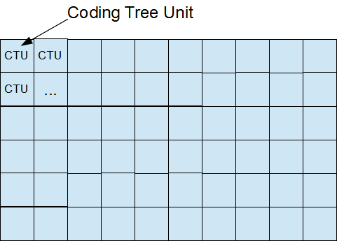
HEVC encoder: depths decision
64x64
Notes:
RD-Cost: amount of distortion (loss of video quality) against the amount of data required to encode the video
BD-rate: measures the bitrate reduction offered by a codec while maintaining the same quality as measured by objective metrics

Slide 6
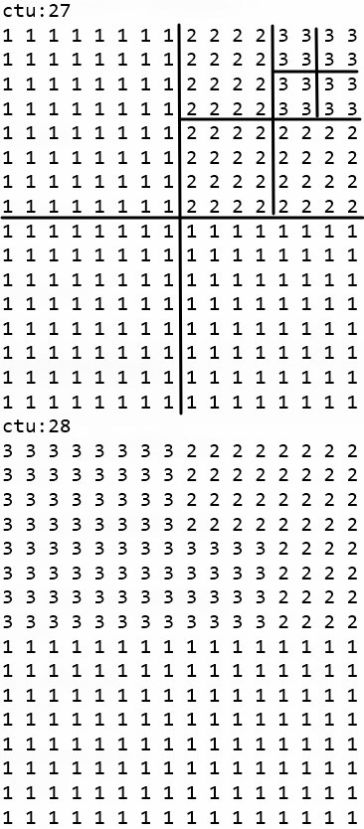


Slide 7
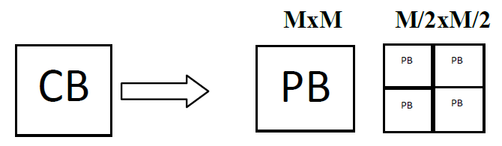
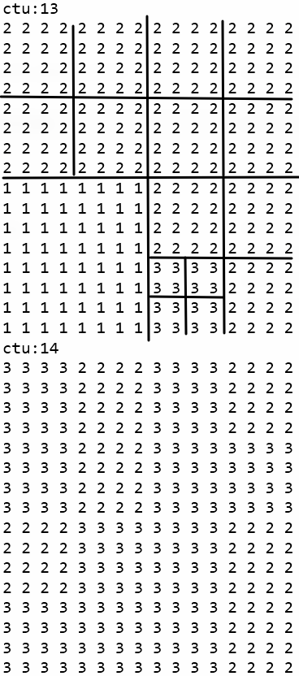

Slide 8
CNN oriented fast CU depths decision
Build the dataset
Data-preprocessing
Build a neural network architecture
Train the model
Evaluate the model on test set
Improve the model

Slide 9
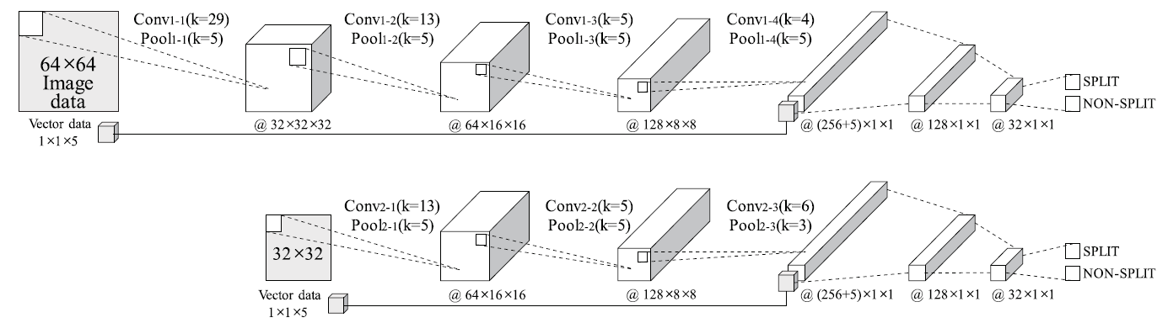
Neural network architecture
Top-down prediction with CNN
Fast CU Depth Decision for HEVC Using Neural Networks
Notes:
reduce the computational overhead by 61.77% on average
with 3.91% (BD rate) degradation

Slide 10
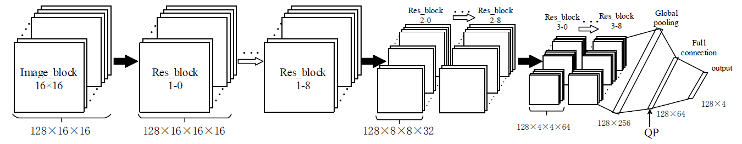
Directly predict the depths with ResNet
ResNet Oriented Fast Mode Decision Algorithm for HEVC Intra Coding
Notes:
reduce around 71.2% encoding time with BDBR increased by 1.75%
and BDPSNR decreased by 0.093dB on average in all I frame encode scheme compared with HEVC testing model

Slide 11
More architectures to try…
Top-down prediction with different CNN architectures
Directly predict all depths from 64x64 pictures (16 labels in total) with CNN
Directly predict all depths from 32x32 pictures (4 labels in total) with CNN
……
replace CNN with ResNet

